Slide 1

Berkeley initiative for transparency in the social sciences
@UCBITSS
bitss
Garret Christensen, Research Fellow
BITSS and Berkeley Institute for Data Science
APHRC– Sep 1, 2015

Slide 2
Why transparency?
Public policy and private decisions are based on evaluation of past events (i.e. research)
So research can affect millions of lives
But what is a “good” evaluation?
Credibility
Legitimacy

Slide 3
Scientific values
Universalism
Anyone can make a claim
Communality
Open sharing of knowledge
Disinterestedness
“Truth” as motivation (≠COI)
Organized skepticism
Peer review, replication
Merton, 1942

Slide 4
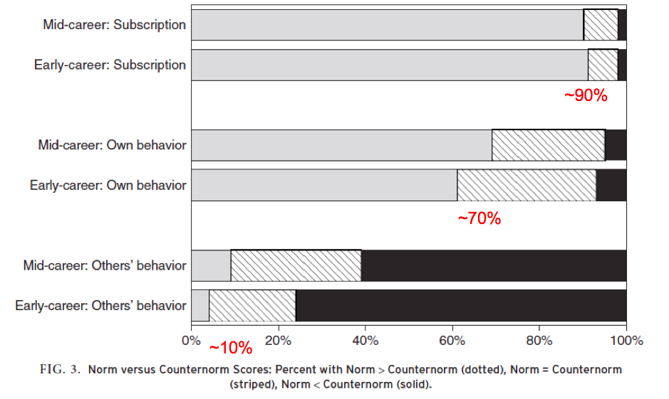
Why we worry…
Anderson, Martin, De Vries 2007

Slide 5

A response:

Slide 6
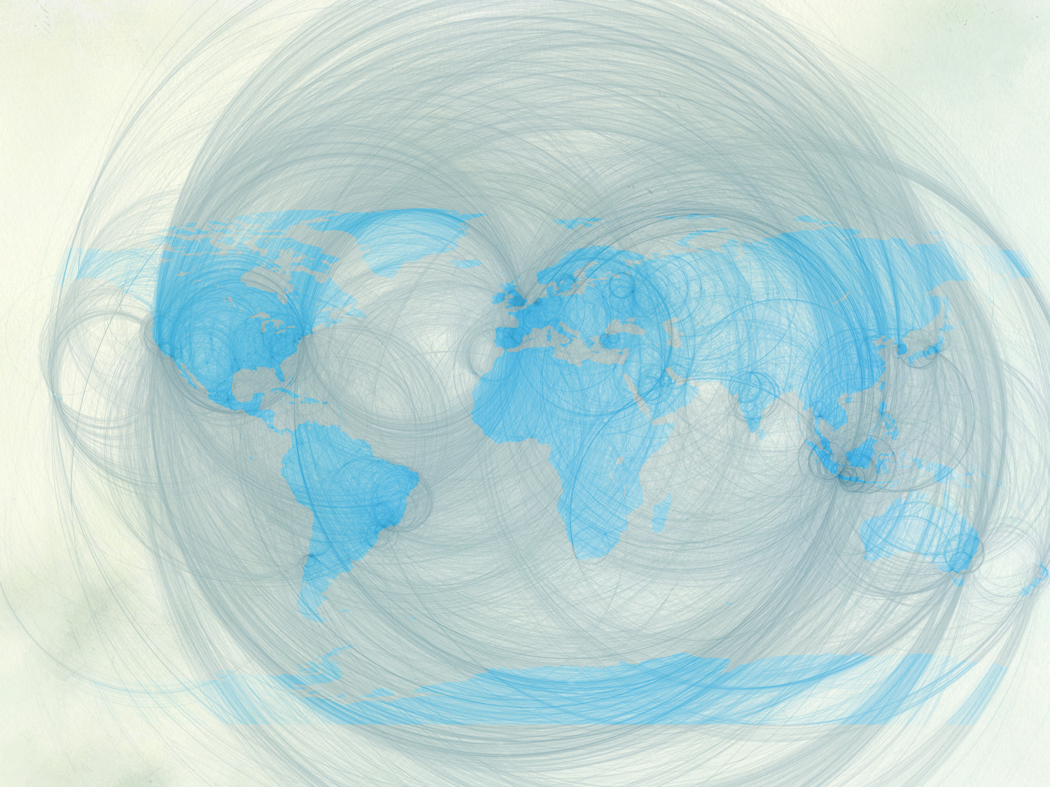











Ecosystem for Open Science

Slide 7
What we’re finding:
Why we worry…
Weak academic norms can distort the body of evidence.
Publication bias (“file drawer” problem)
p-hacking
Non-disclosure
Selective reporting
Failure to replicate
We need more “meta-research” –
evaluating the practice of science

Slide 8

Publication Bias
“File-drawer problem”

Slide 9
Publication Bias
Status quo: Null results are not as “interesting”
What if you find no relationship between a school intervention and test scores? (in a well-designed study…)
It’s less likely to get published, so null results are hidden.
How do we know? Rosenthal 1979:
Published: 3 published studies, all showing a positive effect…
Hidden: A few unpublished studies showing null effect
The significance of positive findings is now in question!

Slide 10
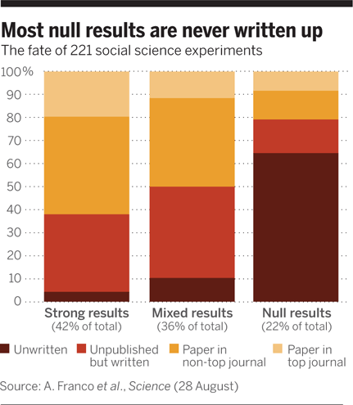
In social sciences…
Notes:
This is a study of researchers who received grants to work with a large, nationally representative data set. Here, the paper authors went back and surveyed all grantees. “Strong” results were 40pp more likely to be published, and 60pp more likely to be written up. The file drawer problem is large. (Franco, Malhotra, Simonovits 2014)

Slide 11
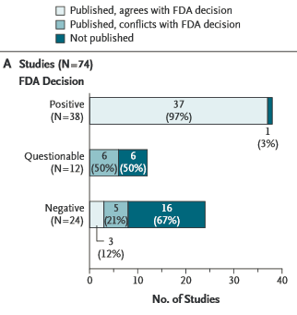
In medicine…
ClinicalTrials.gov
Turner et al. [2008]
Notes:
Publication rates of studies related to FDA-approved antidepressants. (See also Ioannidis [2008].) Nearly all trials with positive outcomes are published, a majority of negative-outcome studies were unpublished – all at four years after the study was completed.
Solution: clinicaltrials.gov
*Publicly state all research you will do, what hypotheses you will test, prospectively.
*Near universal adoption in medical RCTs. Numerous journals won’t publish if it’s not registered.
*Even better if registry requires outcomes from after study. Currently limited, but NIH is moving on this.

Slide 12
p-curves
Scientists want to test hypotheses
i.e. look for relationships among variables (schooling, test scores)
Observed relationships should be statistically significant
Minimize the likelihood that an observed relationship is actually a false discovery
Common norm: probability < 0.05
But null results not “interesting” ...
So incentive is to look for (or report) the positive effects,
even if they’re false discoveries
Notes:
*Also called fishing, researcher degrees of freedom, or data-mining.

Slide 13
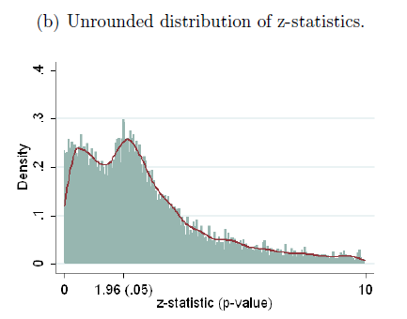
In economics…
Brodeur et al 2015. Data 50,000 tests published in AER, JPE, QJE (2005-2011)
Turner et al. [2008]
Notes:
*Figure 1 shows a skewed distribution of p-values (which are used to determine the statistical significance of results) across various publications. There is a non-random increase in reported p-values just below 0.05 (a value commonly used as a threshold in the social sciences), suggesting researchers are tweaking data to verify hypotheses and increase the likelihood of publication (or else journal editors are discriminating against “barely not significant” estimates.)
This figure alone does not tell us if it is data mining that leads to the skewed results, or if researchers are honest but journal editor discriminate against “barely not significant” estimates. In fact this curve should bend in the opposite direction: there should be more outcomes with p-values above 0.05 – or, for a null effect, we should see a uniform distribution (flat line).
Using 50,000 tests published between 2005 and 2011 in the AER, JPE and QJE, we identify a residual in the distribution of tests that cannot be explained by selection. The distribution of p-values exhibits a camel shape with abundant p-values above :25, a valley between :25 and :10 and a bump slightly under :05. Missing tests are those which would have been accepted but close to being rejected (p-values between :25 and :10). We show that this pattern corresponds to a shift in the distribution of p-values: between 10% and 20% of marginally rejected tests are misallocated. Our interpretation is that researchers might be tempted to inflate the value of their tests by choosing the specification that provides the highest statistics.

Slide 14
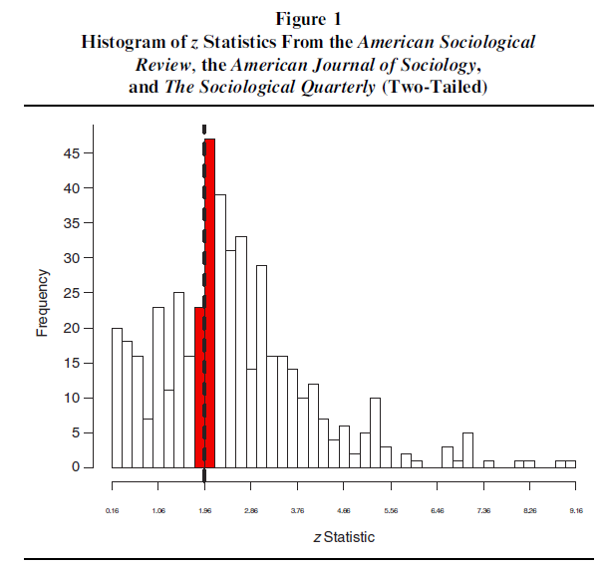
In sociology…
Gerber and Malhotra 2008

Slide 15
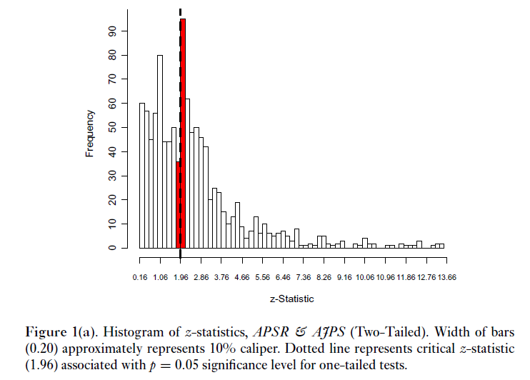
In political science…
Gerber and Malhotra 2008
Notes:
** Explain the x and y axes. Publication bias in political science. A 3-fold jump right at p=0.05.

Slide 16
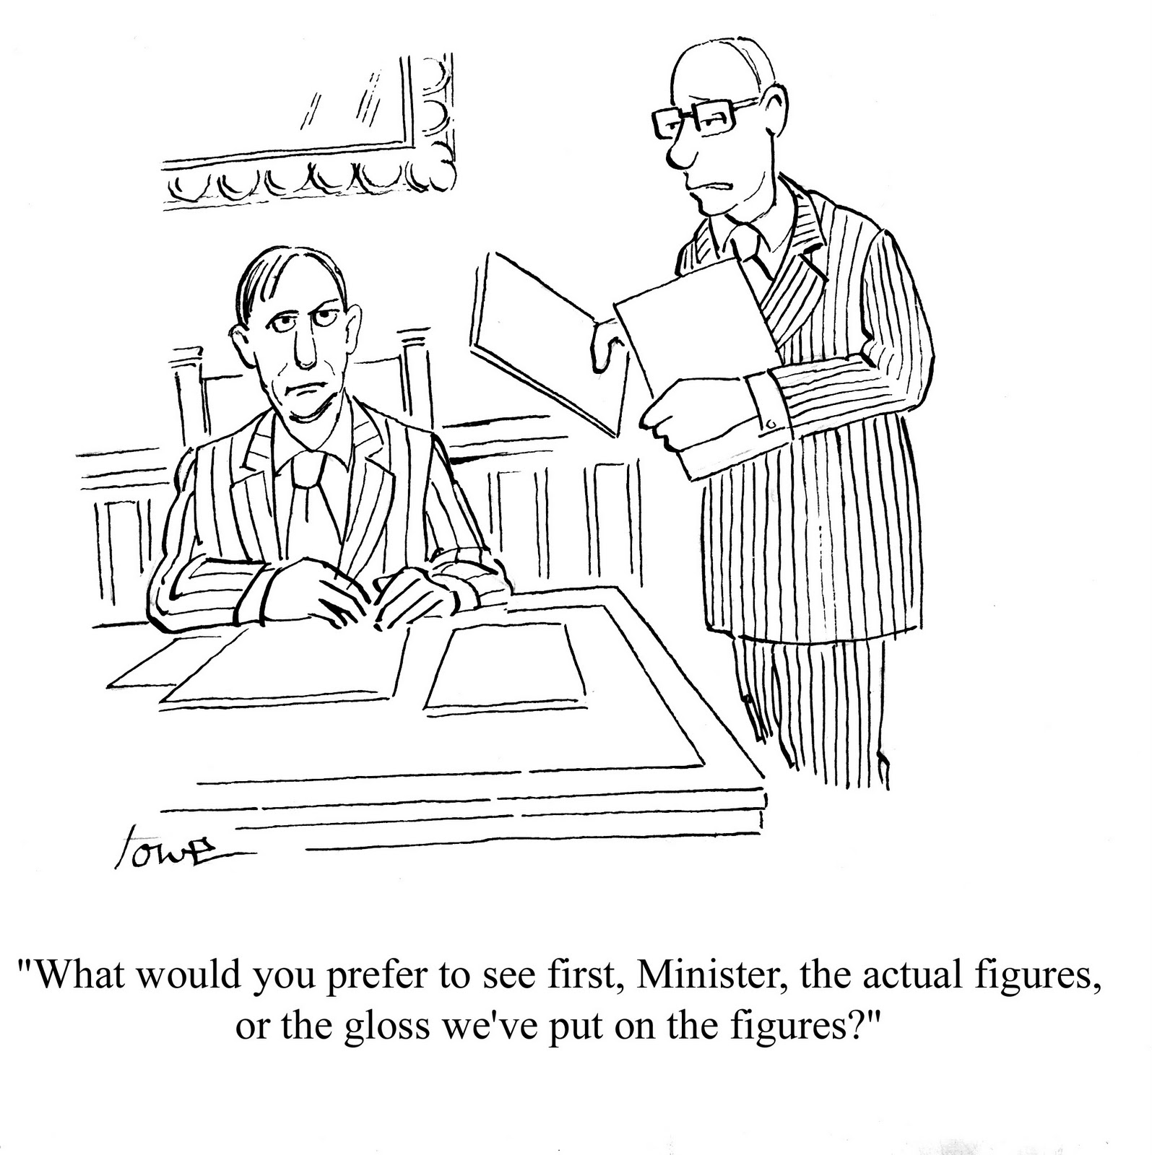

Slide 17
Solution: Registries
Prospectively register hypotheses in a public database
“Paper trail” to solve the “File Drawer” problem
Differentiate confirmatory hypothesis testing from exploratory
Medicine & Public Health: clinicaltrials.gov
Economics: 2013 AEA registry: socialscienceregistry.org
Political Science: EGAP Registry: egap.org/design-registration
Development: 3IE Registry: ridie.3ieimpact.org
Open Science Framework: http://osf.io
Open Questions:
How best to promote registration? Nudges, incentives (Registered Reports, Badges), requirements (journal standards), penalties?
How to adjust for observational (non-experimental) work?

Slide 18
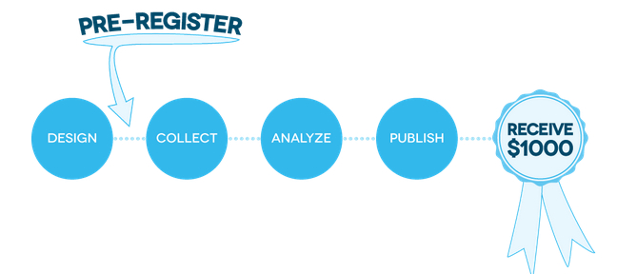
Solution: Registries
$1,000,000 Pre-Reg Challenge
http://centerforopenscience.org/prereg/

Slide 19
Non-disclosure
To evaluate the evidentiary quality of research, we need full universe of methods and results….
Challenge: limited real estate in journals
Challenge: heterogeneous reporting
Challenge: perverse incentives
It’s impossible to replicate or validate findings if methods are not disclosed.

Slide 20
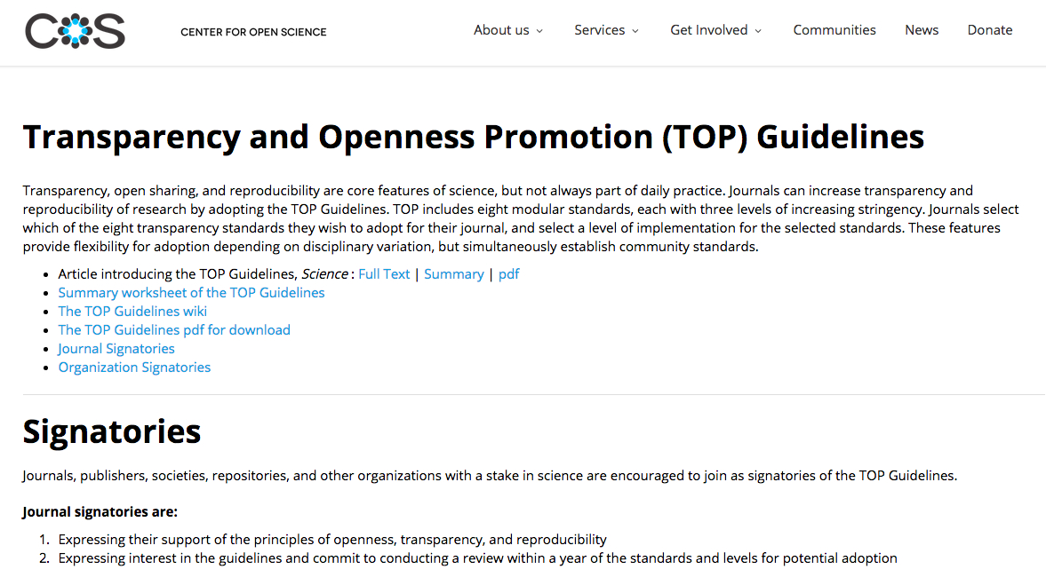
Solution: Standards
https://cos.io/top
Nosek et al, 2015 Science

Slide 21
Grass Roots Efforts
DA-RT Guidelines: http://dartstatement.org
Psych Science Guidelines: Checklists for reporting excluded data, manipulations, outcome measures, sample size. Inspired by grass-roots “psychdisclosure.org”
21 word solution in Nelson, Simmons and Simonsohn (2012): “We report how we determined our sample size, all data exclusions (if any), all manipulations, and all measures in the study.”

Slide 22
Selective reporting
Problem: Cherry-picking & fishing for results
Can result from vested interests, perverse incentives…
You can tell many stories with any data set…
Example: Casey, Glennerster and Miguel (2012, QJE)
Notes:
** Explain the x and y axes. Publication bias in three of the leading general interest journals in economics This figure alone does not tell us if it is data mining that leads to the skewed results, or if researchers are honest but journal editor discriminate against “barely not significant” estimates.
-- Also mention that these findings of publication bias may only be the tip of the iceberg, once you think about all of the studies / results that are never published at all, never see the light of day. There is increasing evidence from the medical trial literature, where registration has been around for a while, that lots of registered studies never get published, or get published slower, and these delayed or vanishing studies are much more likely to have null results.
-- STAR WARS: THE EMPIRICS STRIKE BACK
Abel Brodeury Mathias Léz Marc Sangnierx Yanos Zylberberg{ June 2012
Abstract: Journals favor rejections of the null hypothesis. This selection upon results may distort the behavior of researchers. Using 50,000 tests published between 2005 and 2011 in the AER, JPE and QJE, we identify a residual in the distribution of tests that cannot be explained by selection. The distribution of p-values exhibits a camel shape with abundant p-values above :25, a valley between :25 and :10 and a bump slightly under :05. Missing tests are those which would have been accepted but close to being rejected (p-values between :25 and :10). We show that this pattern corresponds to a shift in the distribution of p-values: between 10% and 20% of marginally rejected tests
are misallocated. Our interpretation is that researchers might be tempted to inflate the value of their tests by choosing the specification that provides the
highest statistics. Note that Inflation is larger in articles where stars are used in order to highlight statistical significance and lower in articles with theoretical models.

Slide 23
Solution: Pre-specify
Define hypotheses
Identify all outcomes to be measured
Specify statistical models, techniques, tests (# obs, sub-group analyses, control variables, inclusion/exclusion rules, corrections, etc)
Pre-Analysis Plans: Written up just like a publication. Stored in registries, can be embargoed.
Open Questions: will it stifle creativity? Could “thinking ahead” improve the quality of research?
Unanticipated benefit: Protect your work from political interests!
Notes:
** Explain the x and y axes. Publication bias in three of the leading general interest journals in economics This figure alone does not tell us if it is data mining that leads to the skewed results, or if researchers are honest but journal editor discriminate against “barely not significant” estimates.
-- Also mention that these findings of publication bias may only be the tip of the iceberg, once you think about all of the studies / results that are never published at all, never see the light of day. There is increasing evidence from the medical trial literature, where registration has been around for a while, that lots of registered studies never get published, or get published slower, and these delayed or vanishing studies are much more likely to have null results.
-- STAR WARS: THE EMPIRICS STRIKE BACK
Abel Brodeury Mathias Léz Marc Sangnierx Yanos Zylberberg{ June 2012
Abstract: Journals favor rejections of the null hypothesis. This selection upon results may distort the behavior of researchers. Using 50,000 tests published between 2005 and 2011 in the AER, JPE and QJE, we identify a residual in the distribution of tests that cannot be explained by selection. The distribution of p-values exhibits a camel shape with abundant p-values above :25, a valley between :25 and :10 and a bump slightly under :05. Missing tests are those which would have been accepted but close to being rejected (p-values between :25 and :10). We show that this pattern corresponds to a shift in the distribution of p-values: between 10% and 20% of marginally rejected tests
are misallocated. Our interpretation is that researchers might be tempted to inflate the value of their tests by choosing the specification that provides the
highest statistics. Note that Inflation is larger in articles where stars are used in order to highlight statistical significance and lower in articles with theoretical models.

Slide 24
Failure to replicate
“Reproducibility is just collaboration with people you don’t know, including yourself next week”—Philip Stark, UC Berkeley
“Economists treat replication the way teenagers treat chastity - as an ideal to be professed but not to be practised.”—Daniel Hamermesh, UT Austin
http://www.psychologicalscience.org/index.php/replication

Slide 25
Why we care
Identifies fraud, human error
Confirms earlier findings (bolsters evidence base)

Slide 26
Replication Resources
Replication Wiki:
http://replication.uni-goettingen.de/
Large-scale Replication Efforts
Reproducibility Project: Psychology
Many Labs
Data/Code Repositories:
Dataverse (IQSS)
ICPSR
Open Science Framework
GitHub

Slide 27
Replication Standards
Replications need to be subject to rigorous peer review (no “second-tier” standards)

Slide 28
Reproducibility
The Reproducibility Project: Psychology is a crowdsourced empirical effort to estimate the reproducibility of a sample of studies from scientific literature. The project is a large-scale, open collaboration currently involving more than 150 scientists from around the world.
https://osf.io/ezcuj/

Slide 29
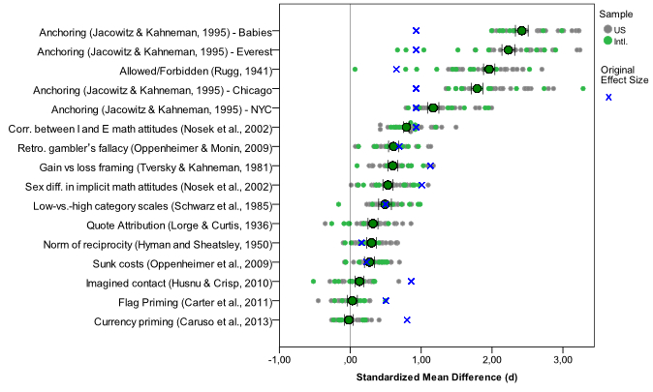
Many Labs
https://osf.io/wx7ck/

Slide 30
Some Solutions…
Why we worry…
Publication bias → Pre-registration
p-hacking → Transparent reporting, Specification curves
Non-disclosure → Reporting standards
Selective reporting → Pre-specification
Failure to replicate → Open data/materials, Many Labs

Slide 31
What does this mean?
In practice:
BEFORE
DURING
AFTER
Pre-register study and pre-specify hypotheses, protocols & analyses
Carry out pre-specified analyses; document process & pivots
Report all findings; disclose all analyses; share all data & materials

Slide 32



In practice:
Report everything another researcher would need to replicate your research:
Literate programming
Follow consensus reporting standards
What are the big barriers you face?
Notes:
(1) Post your code and your data in a trusted public repository.
*Find the appropriate repository:
http://www.re3data.org/
*Repositories will last longer than your own website.
*Repositories are more easily searchable by other researchers.
*Repositories will store your data in a non-proprietary format that won’t become obsolete.
(2) Literate programming: write and command your code in a way that can be understood by humans, not only machines
(3) CONSORT for medical trials, not really in social science – but some good resources are being developed.

Slide 33
BITSS Focus
RAISING AWARENESS
IDENTIFYING STRATEGIES
FOSTERING ADOPTION
about systematic weaknesses in current research practices
and tools for increasing transparency and reproducibility
of approaches that best promote scientific integrity

Slide 34
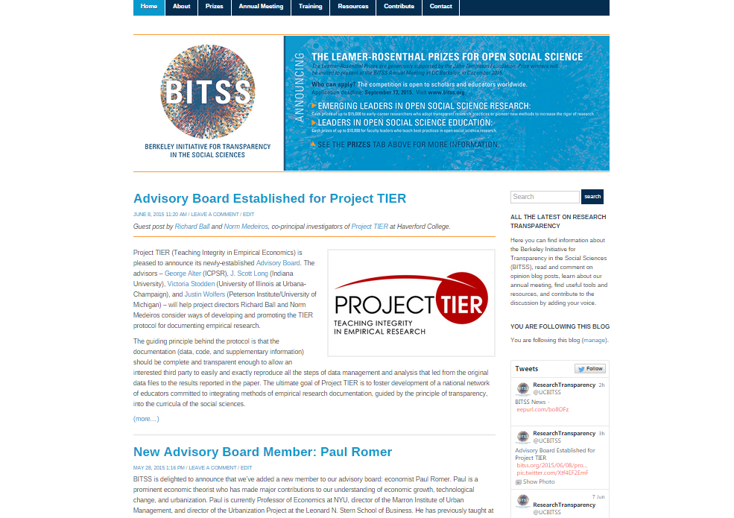
Raising Awareness

Slide 35
Raising Awareness
Social Media: bitss.org, @UCBITSS
Publications
Best Practices Manual https://github.com/garretchristensen/BestPracticesManual
Textbook, MOOC
Sessions at conferences: AEA/ASA, APSA, OpenCon
BITSS Annual Meeting (December 2015)
Notes:
Social Media
*blog
*twitter
Publications
*Science article
*manual of best practices
Sessions at conferences
*AEA, APSA (booth this september in SF), CGD

Slide 36
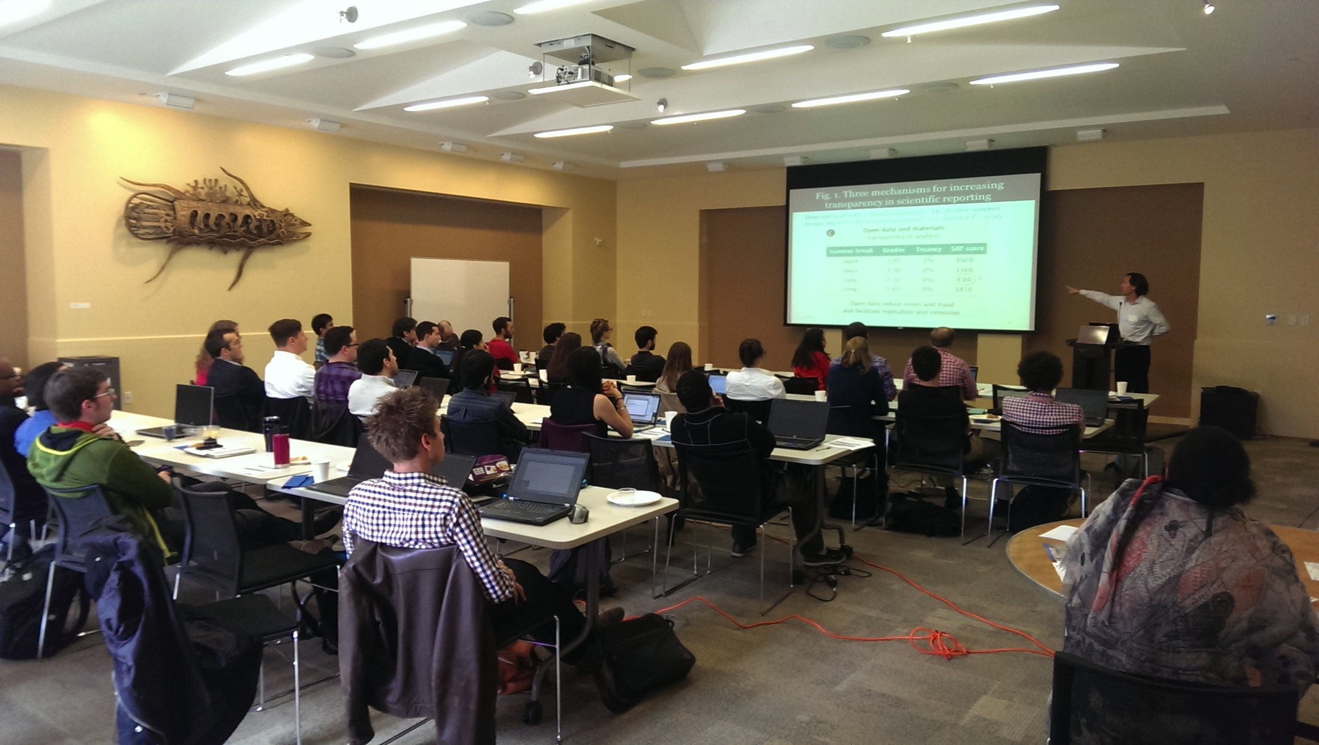
Identifying Strategies
Tools
Open Science Framework: osf.io
Registries: AEA, EGAP, 3ie, Clinicaltrials.gov
Coursework
Syllabi
Slide decks
Notes:
Tools development
*Work closely with data scientists (including in Silicon Valley)
Coursework development
*Workshops on transparency: 1h, half-day, full-day, one week, one semester (Ted’s class) *MOOC
*Eventually, we think these topics should become full part of the actual teaching of social science

Slide 37
Fostering Adoption
Annual Summer Institute in Research Transparency (bitss.org/training/)
Consulting with COS (centerforopenscience.org/stats_consulting/)
Meta-research grants
(bitss.org/ssmart)
Leamer-Rosenthal Prizes for Open Social Science (bitss.org/prizes/)
Notes:
*SumInst 2014: A total of 32 participants were selected from 57 applications, representing a total of 13 academic institutions in the US, six overseas, and four research non-profits.
*This year: over 80 applications
*COS: Help-desk

Slide 38
Sept 6th: Apply
SSMART Grants
New methods to improve the transparency and credibility of research?
Systematic uses of existing data (innovation in meta-analysis) to produce credible knowledge?
Understanding research culture and adoption of new norms?
More info: http://bitss.org/ssmart

Slide 39

Sept 30th: Nominate

Slide 40



Questions?
bitss.org
cega.org
@UCBITSS

